Slide 1
BST 270
Reproducible
Data Science
Spring 2019

Slide 2
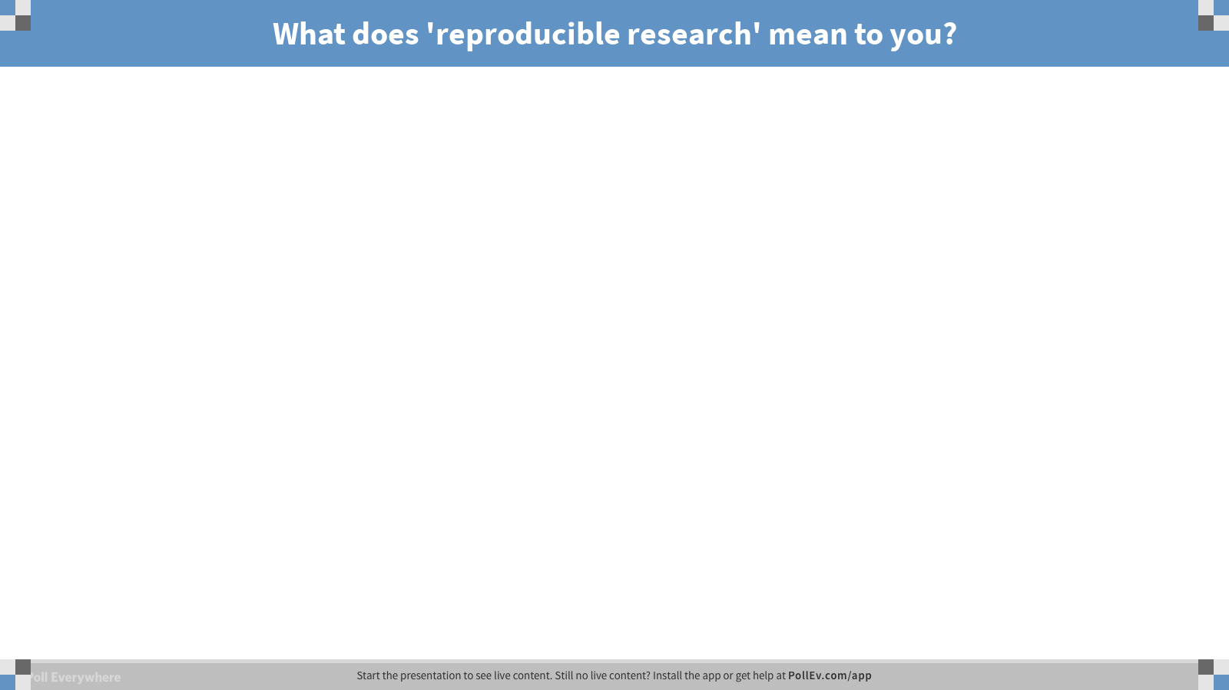
Notes:
What does 'reproducible research' mean to you?
https://www.polleverywhere.com/free_text_polls/uTolCQw2y4usvrm

Slide 3
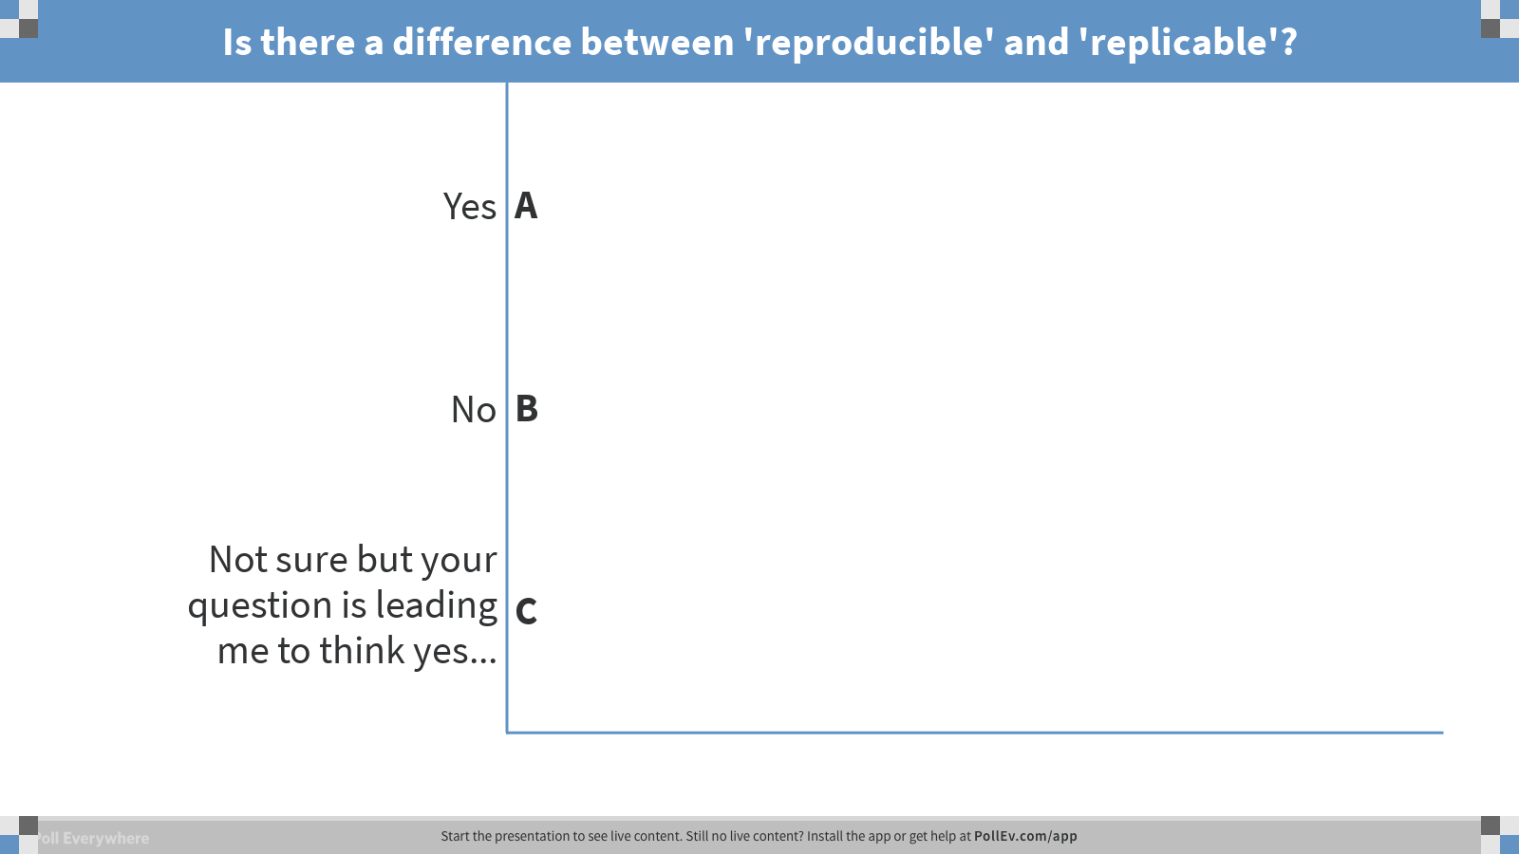
Notes:
Is there a difference between 'reproducible' and 'replicable'?
https://www.polleverywhere.com/multiple_choice_polls/ZEO8ng0xkPfSUCjNv235l

Slide 4
Reproducible: when a result can be regenerated exactly as suggested given the same set of inputs and parameters.
Replicable: when a result or similar performance can be generated with similar or different methods than the one proposed on the same or possibly slightly different data.

Slide 5
Teaching Staff
Heather Mattie
Instructor of Data Science
Email: hemattie@hsph.harvard.edu
Office Hour: Mondays 5:15-6:15pm or by appointment
Office: Building 1, 4th floor, room 421A
Matt Ploenzke
PhD Candidate, Biostatistics
Email: ploenzke@g.harvard.edu
Office hour: Fridays 12-1pm in Heather's office

Slide 6
Course Details
Mondays 3:45-5:15pm
FXB G3
2.5 credits (Pass/Fail)
A minimum of 70% is needed for a Pass
Grading
50% homework and in-class participation
10% attendance
40% group project
Holidays (no class)
February 18th
March 18th

Slide 7
Course Details
Course videos
edx.org
Course GitHub
BST270-Spring2019
Optional reading
Christopher Gandrud (2015), Reproducible Research with R and RStudio, 2nd Ed.
Kitzes, Turek, Deniz (2017), The Practice of Reproducible Research: Case Studies and Lessons from the Data-Intensive Sciences, 1st Ed.

Slide 8
Module 1: Introduction to Reproducible Science

Slide 9
Module 1 Videos
1.1 Welcome to Reproducible Science
1.2.1 Intro to the People/Faculty
1.3 Intro to the Modules

Slide 10
In-Class Project

Slide 11
We will attempt to reproduce the results from and critique the reproducibility of:
[1] Boehm, J. K., Williams, D. R., Rimm, E. B., Ryff, C., \& Kubzansky, L. D. (2013). Relation between Optimism and Lipids in Midlife. The American Journal of Cardiology, 111(10), 1425-1431.
Specific Tasks:
Figure 1
Tables 1-5
Critique reproducibility

Slide 12
MIDUS II Data Sets
Data and supporting codebook and other documents
Biomarker data
This particular article focuses only on MIDUS II data, including biomarker data, and investigates the relationship between optimism and lipids. You can download the data in multiple formats. We will be using the R files in class and performing all data cleaning and analyses in R and an RMarkdown file.

Slide 13
Homework
Create GitHub account
Clone class repository
Read [1]
Watch Module 2 videos

